Slide 1
DOCTOR ANYWHERE · PAID MEDIA AUDIT
GHS & SODA Paid Ads: Performance Audit
Spend, return, and what we'd change next · 1 Jan – 30 June 2026

Slide 2
Caveat
Context
Context
2025 was Google-heavy; 2026 introduced new channel testing across the mix.
Attribution
Working under a constrained condition with no Singular cross-channel attribution — Joined VC tracking exists on Google only. Singular integration is in the works to close this gap; figures should be read as directional until live.
Funnel shift
2025 focused on bottom-funnel, conversion-ready demand; 2026 expanded into full-funnel activity across the new channels. Some underperformance in this period reflects early-stage upper and mid-funnel learning, not steady-state channel performance.

Slide 3
Learnings
Overall learnings from H1 2026
No | Learnings | How it shaped the recommendation
1 | Some of our data foundations need work. A few channels lack revenue tracking (Meta/ASA on VC, SODA beyond Google), and some AOVs are narrower than the real service scope (MOBS), so a few "weak" numbers may reflect gaps, not real underperformance. | We're holding spend steady on those channels and prioritizing the tracking/AOV fixes before making bigger calls.
2 | Creative angle seems to matter more than the channel itself. Each top-performing ad won by speaking to one specific concern, such as speed, lifestyle, customisation, loss-aversion, rather than a generic pitch. | Extending MedSuites' lifestyle-led creative to VC's Meta ads, which still leans towards purchase-intent audiences.
3 | Meta performs very differently depending on the product. It's MedSuites' strongest channel and MOBS' weakest. | Shifting Meta budget from MOBS toward MedSuites, the clearest reallocation we found.
4 | LinkedIn hasn't found its fit yet. High cost, little confirmed return across both MOBS and SODA. | Paused in both MOBS and SODA, with spend redirected to stronger channels.
5 | H1 2026 was a deliberate testing period. We moved from 2025's Google-heavy, bottom-funnel focus to testing new channels across the full funnel, so some softness likely reflects early learning rather than failure. | Keeping smaller awareness channels like TikTok running rather than cutting on ROAS alone, while pausing genuinely dead spend like Taboola.

Slide 4
EXECUTIVE SUMMARY - GHS
Spend & return at a glance
TOTAL PAID SPEND
TOTAL REVENUE
BLENDED ROAS
$543,326.39
$1,204,277.78
2.22x
Jan–June · VC + MedSuites + MOBS
conversions × avg bill
revenue ÷ spend
Sub-unit | Spend | Conversions | Revenue | ROAS | Conversion Rate
VC — Virtual Consult | $376,737.92 | 45,294 | $864,462.72 | 2.29x | 15.21%
MedSuites | $39,642.00 | 529 | $235,828.20 | 5.95x | 0.98%
MOBS | $126,946.47 | 562 | $103,986.86 | 0.81x | 0.39%
Headline: VC is the volume engine, MedSuites is the highest return per dollar spent, but MOBS is spending more than it generates. Resolving this one unit is what moves the overall portfolio’s needle.

Slide 5
VC · PERFORMANCE
Virtual Consult: Core acquisition engine
SPEND
CONVERSIONS
REVENUE
ROAS
$376,737.92
45,294
$864,462.72
2.29x
Jan–June, paid
Join VCs / installs
= conv × $40.26
revenue ÷ spend
Channel | Spend | Conv | Cost per Conv. | Revenue | ROAS
Google | $300,915.67 | 21,472 | $14.01 | $864,462.72 | 2.87x
Meta | $47,563.37 | 4,822 | $9.86 | N/A | N/A
Apple Search Ads | $17,270.03 | 19,555 | $0.88 | N/A | N/A
Taboola Ads | $5,573.54 | 4 | $1,393.39 | N/A | N/A
TikTok Ads | $2,824.04 | 71 | $39.78 | N/A | N/A
LinkedIn Ads | $2,591.27 | N/A | N/A | N/A | N/A
TOTAL | $376,737.92 | 45,294 | $8.32 | $864,462.72 | 2.29x
Insight
Google is the only channel with Joined VC tracking and carries all measurable revenue at 2.87x ROAS; all other channels report app installs only — channel-level ROAS beyond Google cannot be confirmed.
Next Month: Pause Taboola; review LinkedIn for corporate-focused campaigns; keep TikTok for lightweight awareness; reinforce Google with higher budget allocation; maintain Meta and ASA spend pending cross-channel tracking validation.
Revenue = conversions × $40.26 avg bill. ROAS = revenue ÷ spend. First-transaction basis.
Notes:
Google conv. = Joined VC
Meta, Apple Search, Taboola, TikTok conv. = App Install

Slide 6
VC · PERFORMANCE
Virtual Consult: Updated Data with Conv. Rate
Channel | Spend | Conv | Cost per Conv. | Revenue | ROAS | Conv. Rate
Google | $300,915.67 | 21,472 | $14.01 | $864,462.72 | 2.87x | 11.70%
Meta | $47,563.37 | 4,822 | $9.86 | N/A | N/A | 10.09%
Apple Search Ads | $17,270.03 | 19,555 | $0.88 | N/A | N/A | 95.30%
Taboola Ads | $5,573.54 | 4 | $1,393.39 | N/A | N/A | 0.01%
TikTok Ads | $2,824.04 | 71 | $39.78 | N/A | N/A | 0.45%
LinkedIn Ads | $2,591.27 | N/A | N/A | N/A | N/A | N/A
TOTAL | $376,737.92 | 45,294 | $8.32 | $864,462.72 | 2.29x | 15.21%
Revenue = conversions × $40.26 avg bill. ROAS = revenue ÷ spend. First-transaction basis.
Notes:
CVR calculation for GHS & SODA

Slide 7
MEDSUITES · PERFORMANCE
Health screening: Highest basket value
SPEND
CONVERSIONS
REVENUE
ROAS
$39,642.00
529
$235,828.20
5.95x
Jan–June, paid
purchases
= conv × $445.80
revenue ÷ spend
Channel | Spend | Conv | Cost per Conv | Revenue | ROAS
Google | $17,119.68 | 127 | $134.80 | $56,616.80 | 3.31x
Meta | $22,522.32 | 402 | $56.03 | $179,211.60 | 7.96x
TOTAL | $39,642.00 | 529 | $74.94 | $235,828.20 | 5.95x
Insight:
Meta leads on efficiency at 7.96x ROAS and $56.03 cost per conversion vs Google's 3.31x, though with marketplace purchases. True ROAS is likely higher across both channels.
Next month: Scale Meta budget by reallocating from underperforming Google campaigns; consolidate Google spend into Search and Pmax only; activate Longevity campaign on both channels from July.
Revenue = conversions × $445.80 avg bill. ROAS = revenue ÷ spend. First-transaction basis.
Notes:
Conversions are mainly marketplace purchases. Did not take into account form submissions

Slide 8
Medsuites · PERFORMANCE
Medsuites: Updated Data with Conv. Rate
Channel | Spend | Conv | Cost per Conv | Revenue | ROAS | Conv. Rate
Google | $17,119.68 | 127 | $134.80 | $56,616.80 | 3.31x | 0.80%
Meta | $22,522.32 | 402 | $56.03 | $179,211.60 | 7.96x | 1.05%
TOTAL | $39,642.00 | 529 | $74.94 | $235,828.20 | 5.95x | 0.98%
Revenue = conversions × $445.80 avg bill. ROAS = revenue ÷ spend. First-transaction basis.
Notes:
Google conv. = Joined VC
Meta, Apple Search, Taboola, TikTok conv. = App Install

Slide 9
MOBS · PERFORMANCE
Mobile Services (MOBS)
SPEND
CONVERSIONS
REVENUE
ROAS
$126,946.47
562
$103,986.86
0.81x
Jan–June, paid
bookings
= conv × $185.03
revenue ÷ spend
Channel | Spend | Conv | Cost per Conv | Revenue | ROAS
Google | $81,867.66 | 445 | $183.97 | $82,338.35 | 1.00x
Meta | $40,533.56 | 117 | $346.44 | $21,648.51 | 0.53x
LinkedIn | $2,300.00 | N/A | N/A | N/A | N/A
TikTok | $2,245.25 | N/A | N/A | N/A | N/A
TOTAL | $126,946.47 | 562 | $225.88 | $103,986.86 | 0.81x
Insight:
ROAS is understated, as ABS reflects home care only and excludes form submission conversions; Google breakeven at 1.00x, Meta underperforms at 0.53x; LinkedIn and TikTok are top-funnel only.
Next Month: Establish a blended MOBS AOV across all service types; consolidate spend into Google as the stronger direct-response channel; reduce Meta until cost per booking improves; pause LinkedIn and TikTok.
Revenue = conversions × $185.03 avg bill. ROAS = revenue ÷ spend. First-transaction basis.
Conversion = Bookings
Notes:
Mainly track marketplace purchase. Did not take into account form submissions
LinkedIn and TikTok were mainly top funnel campaigns
MOBS here consist of house call, vaccines, health screening, etc.

Slide 10
MOBS · PERFORMANCE
MOBS: Updated Data with Conv. Rate
Channel | Spend | Conv | Cost per Conv | Revenue | ROAS | Conv. Rate
Google | $81,867.66 | 445 | $183.97 | $82,338.35 | 1.00x | 0.49%
Meta | $40,533.56 | 117 | $346.44 | $21,648.51 | 0.53x | 0.22%
LinkedIn | $2,300.00 | N/A | N/A | N/A | N/A | N/A
TikTok | $2,245.25 | N/A | N/A | N/A | N/A | N/A
TOTAL | $126,946.47 | 562 | $225.88 | $103,986.86 | 0.81x | 0.39%
Revenue = conversions × $185.03 avg bill. ROAS = revenue ÷ spend. First-transaction basis.
Conversion = Bookings
Notes:
Mainly track marketplace purchase. Did not take into account form submissions
LinkedIn and TikTok were mainly top funnel campaigns
MOBS here consist of house call, vaccines, health screening, etc.

Slide 11
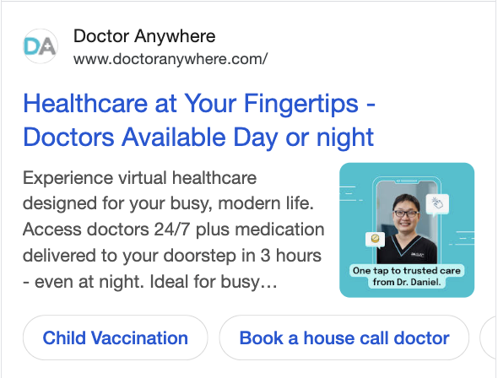

WHAT'S WORKING · CREATIVE
Top creatives by sub-unit
VC — Doctor in 5 mins
Medsuites — Health Screening
Key metric: ROAS - 24.49x
Hook / format: 30-second Meta video; opens on calm lifestyle imagery with empowerment-led copy ("stay strong, stay sharp")
Why it works: Lifestyle and aspiration framing over clinical messaging lowers purchase anxiety for a considered health decision. Due to premium pricing, emotional resonance drives conversion better than a transactional approach.
Key metric: ROAS - 3.38x
Hook / format: Pmax responsive ad; speed and 24/7 accessibility as the core hook.
Why it works: Directly addresses the biggest barrier to VC adoption: Time. "Doctor in 5 mins" reframes healthcare as instant and frictionless, resonating with busy urban users who associate seeing a doctor with waiting.

Slide 12
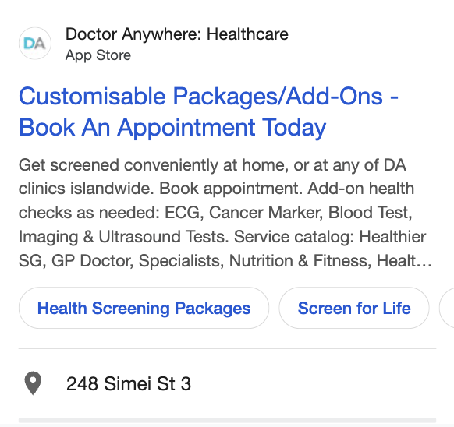
WHAT'S WORKING · CREATIVE
Top creatives by sub-unit
MOBS — Public Health Screening
Hook / format: Responsive search ad; leads with customisability ("Customisable Packages/Add-Ons") paired with a direct booking CTA
Why it works: Customisation is potentially a right hook for health screening. The key purchase barrier is relevance, not price. By signalling flexibility upfront and listing specific test, the ad pre-answers "does this cover what I need?" before the user even clicks, which drives higher-intent traffic to the booking page.
Key metric: ROAS - 2.97x

Slide 13
EXECUTIVE SUMMARY - SODA
Spend & return at a glance
TOTAL PAID SPEND
Closed Deals
$53,875.22
25
Jan–June · SODA only
customers won
Sub-unit | Spend | Closed Deals
SODA | $53,875.22 | 25
Headline: Paid contributed to 25 closed deals in H1, but without CRM source attribution or validated deal values, we're closing business without knowing which channel or message is driving it. Fixing that is the highest-leverage action for H2.

Slide 14
SODA · PERFORMANCE
SODA
SPEND
Leads
Closed Deals
$53,875.22
234
25
Jan–June, paid
Form submissions
Customers Won
Channel | Spend | Leads | Cost per Lead | Closed Deals | Conv. Rate
Google | $24,955.40 | 120 | $207.96 | 25 | 1.59%
Meta | $18,545.47 | 95 | $195.22 | - | 8.67%
LinkedIn | $10,374.35 | 19 | $546.02 | - | 0.50%
TOTAL | $53,875.22 | 234 | $230.24 | 25* | 1.88%
Insight:
Google carries all 25 sales-tracked closed deals, though attribution is based on sales team tagging rather than UTM; Meta has the lowest CPL but no source tracking in CRM; LinkedIn's CPL is relatively higher than average B2B benchmarks and remains unvalidated against deal outcomes.
NEXT MONTH: Fix lead source capture in CRM to enable channel-level deal attribution; maintain Google as primary channel; pause LinkedIn while we rework the targeting strategy; validate Meta's lead quality with sales team before increasing spend.
*Closed deals sourced from sales tracker; attributed to ads by sales team, not tied to UTM tracking. Channel-level breakdown not available.
Notes:
Closed deal based on this sheet:
https://docs.google.com/spreadsheets/d/1n7NKO1r53FrmOoicwTjUvsS-aJH7bt6U_wygyYRyu3k/edit?gid=0#gid=0

Slide 15
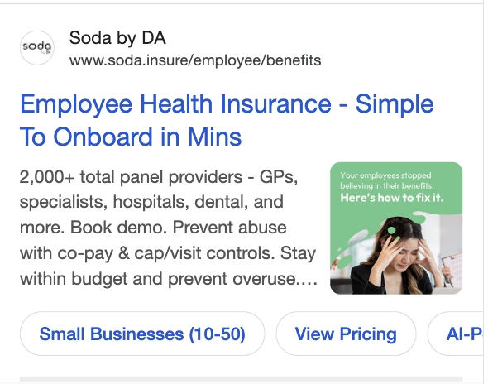
WHAT'S WORKING · CREATIVE
Top creative
SODA — Employee Benefits
Key metric: CPL - $163.48
Hook / format: Responsive search ad; dual-focused hook as headline leads with ease of onboarding ("Simple To Onboard in Mins"), while image creative leads with loss aversion ("Your employees stopped believing in their benefits").
Why it works: The headline neutralises the primary SME objection, which is implementation complexity, while the image creative triggers loss aversion by making disengaged employees the threat. The sitelink "Small Businesses (10–50)" pre-qualifies intent before the click, which filters for the right audience and drives higher conversion efficiency.

Slide 16
RECOMMENDATIONS
Next month: Budget & optimization
BU | June Period | Recommended for July | Forecasted Volume | Forecasted Revenue | Rationale
VC | $12,894.15 | $35,334 | 1,963 Joined VCs | $79,030 | Reinforcing Google after pausing Taboola and reviewing LinkedIn as its the only channel with confirmed Joined VC revenue.
MedSuites | $5,842.53 | $19,000 | 158 Bookings | $70,436 | Scaling Meta (8x ROAS) by reallocating from Google; Longevity campaign activates on both channels in July.
MOBS | $9,308.83 | $9,000 | 50 Bookings | $9,252 | Budget maintain while consolidating into Google and reducing Meta; LinkedIn and TikTok paused pending blended AOV validation.
SODA | $5,638.72 | $5,000 | 21 Leads | N/A | Reallocating LinkedIn spend into Google, as its the only channel with confirmed closed-deal attribution, while CRM source mapping gets fixed.
TOP OPTIMIZATION ACTIONS
Shift Meta budget from MOBS to MedSuites. Same channel, opposite returns, and the single highest-leverage reallocation available in the portfolio.
Extend MedSuites' lifestyle and aspiration angle to VC's Meta creative, which still leans transactional; pause Taboola ads entirely for the BUs.
Fix SODA's UTM-to-CRM lead source mapping and establish a blended MOBS AOV across service lines as both BUs are scaling July budget on incomplete attribution.
Notes:
Total recommended budget for July:
GHS: $63,334
SODA: $5,000

Slide 17
APPENDIX
How these numbers were built
Period
1 Jan – 30 June 2026. Paid advertising only — organic and CRM excluded.
Conversions
Platform-reported actuals (Google, Meta, TikTok, Apple Search Ads). Each platform is last-click on its own data; cross-platform overlap is not de-duplicated.
Revenue
Conversions × average bill — VC $40.26, MedSuites $445.80, MOBS $185.03 (YTD actuals). Single-transaction, not lifetime.
ROAS
Revenue ÷ paid spend, first-transaction basis.
MOBS scope
Confirm conversions/revenue cover all MOB services. The Home Care dashboard alone understates MOBS materially.

